Slide 1
Section 6.8
Exponential Growth and Decay Models;
Newton’s Law;
Logistic Growth and Decay Models
Copyright © 2012 Pearson Education, Inc. Publishing as Prentice Hall.

Slide 2

Copyright © 2012 Pearson Education, Inc. Publishing as Prentice Hall.

Slide 3
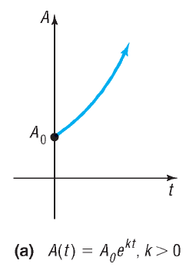
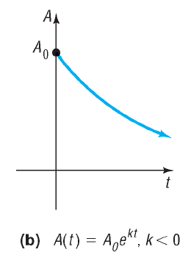
Copyright © 2012 Pearson Education, Inc. Publishing as Prentice Hall.

Slide 4
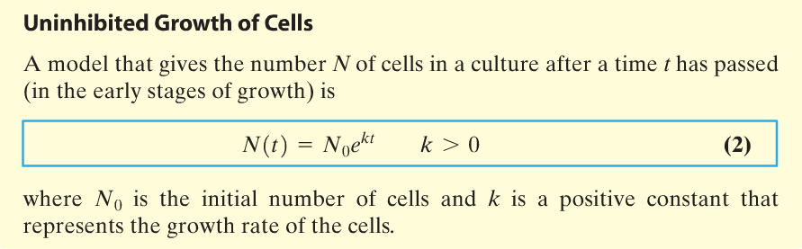
Copyright © 2012 Pearson Education, Inc. Publishing as Prentice Hall.

Slide 5


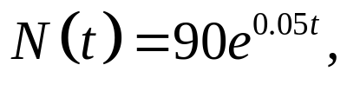
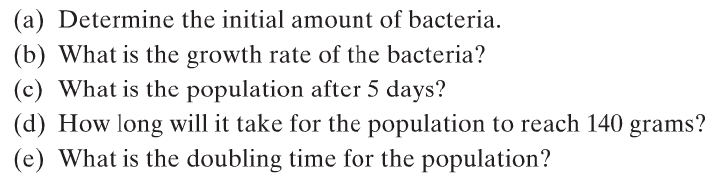

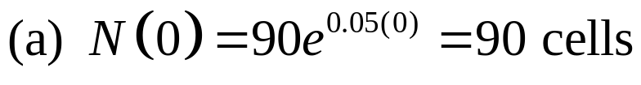

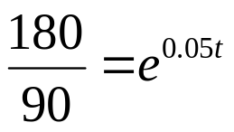

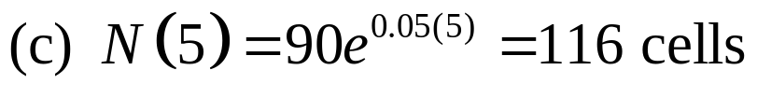

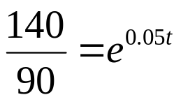
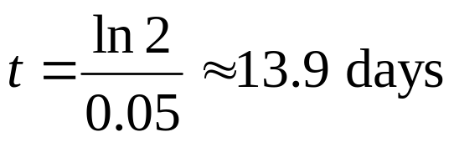
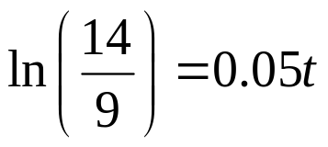
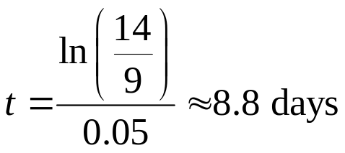
A colony of bacteria grows according to the law of uninhibited growth according to the function
where N is measured in grams and t is measure in days.
Copyright © 2012 Pearson Education, Inc. Publishing as Prentice Hall.

Slide 6
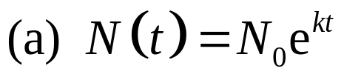
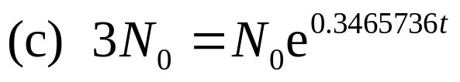
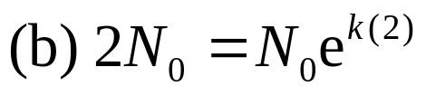



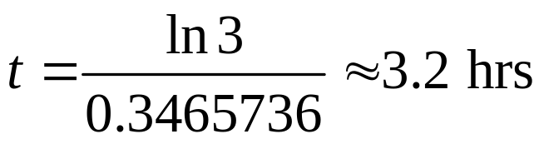

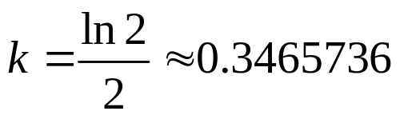
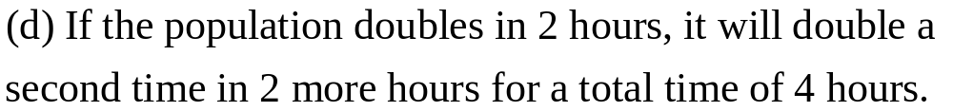
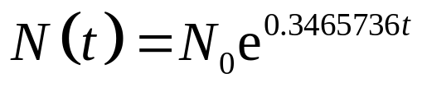
A colony of bacteria increases according to the law of uninhibited growth.
If N is the number of cells and t is the time in hours, express N as a function of t.
If the number of bacteria doubles in 2 hours, find the function that gives the number of cells in the culture.
How long will it take for the size of the colony to triple?
How long will it take for the population to double a second time (that is increase four times)?
Copyright © 2012 Pearson Education, Inc. Publishing as Prentice Hall.

Slide 7
Copyright © 2012 Pearson Education, Inc. Publishing as Prentice Hall.

Slide 8
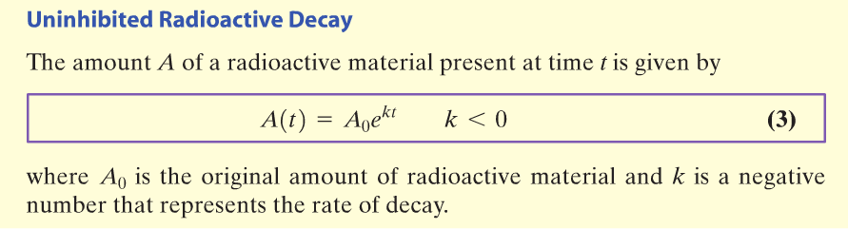
Copyright © 2012 Pearson Education, Inc. Publishing as Prentice Hall.

Slide 9
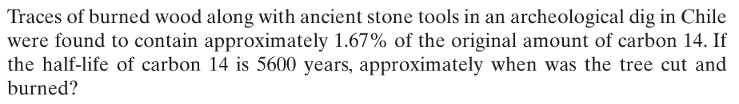
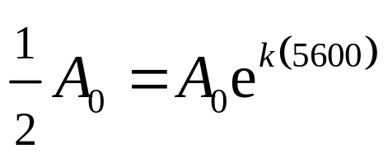
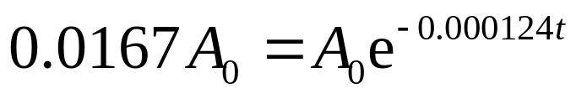
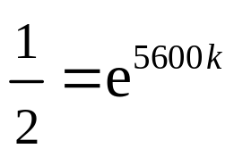

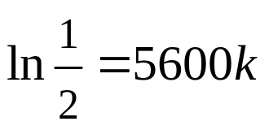

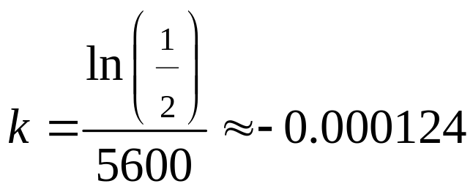
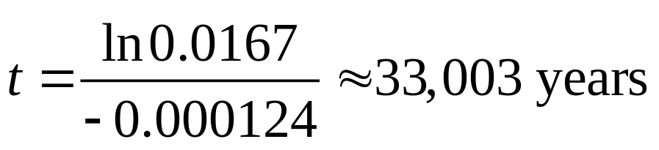

Copyright © 2012 Pearson Education, Inc. Publishing as Prentice Hall.

Slide 10

Copyright © 2012 Pearson Education, Inc. Publishing as Prentice Hall.

Slide 11
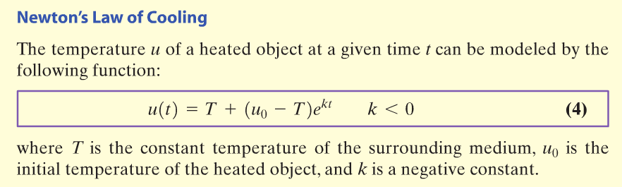
Copyright © 2012 Pearson Education, Inc. Publishing as Prentice Hall.

Slide 12

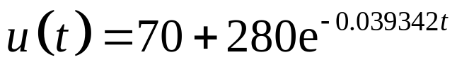
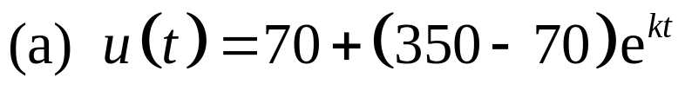

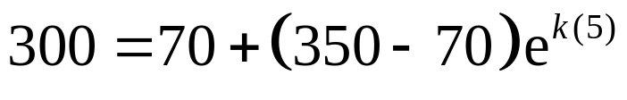
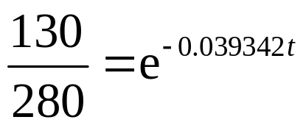

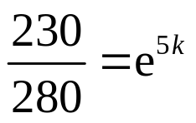
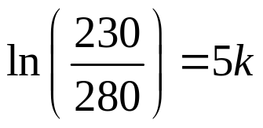
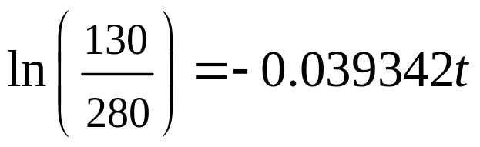
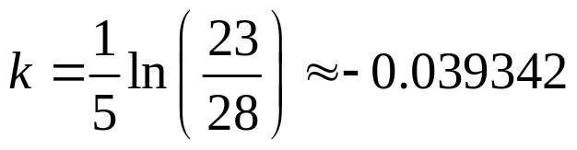
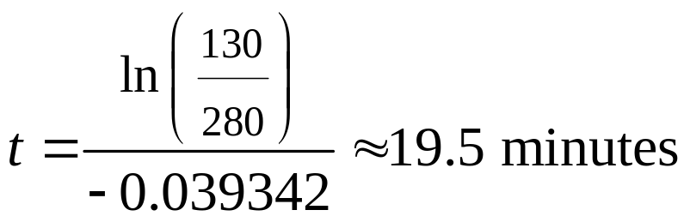
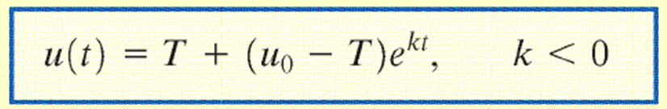
A cake is heated to 350°F and is then allowed to cool in a room whose air temperature is 70°F.
If the temperature of the cake is 300°F after 5 minutes, when will its temperature be 200°F?
Use u(5) = 300 to find k.
Copyright © 2012 Pearson Education, Inc. Publishing as Prentice Hall.

Slide 13
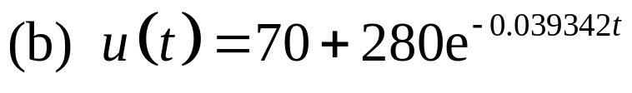
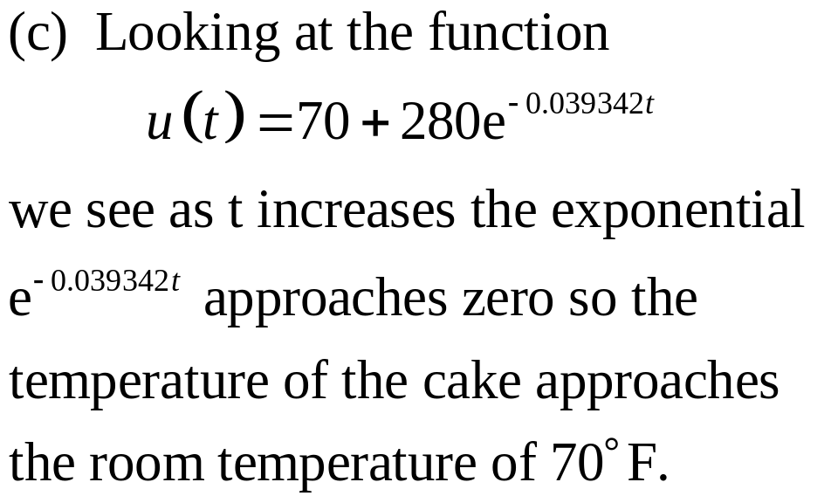

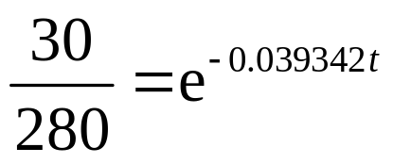
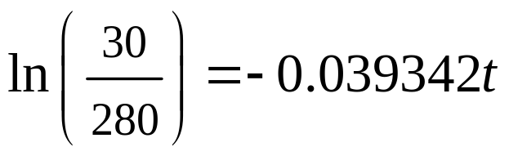
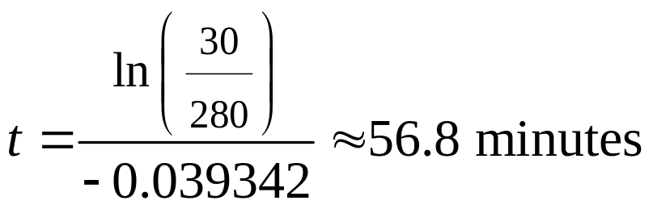
A cake is heated to 350°F and is then allowed to cool in a room whose air temperature is 70°F.
Determine the elapsed time before the temperature of the cake is 100°F.
What do you notice about the temperature as time passes?
Copyright © 2012 Pearson Education, Inc. Publishing as Prentice Hall.

Slide 14

Copyright © 2012 Pearson Education, Inc. Publishing as Prentice Hall.

Slide 15
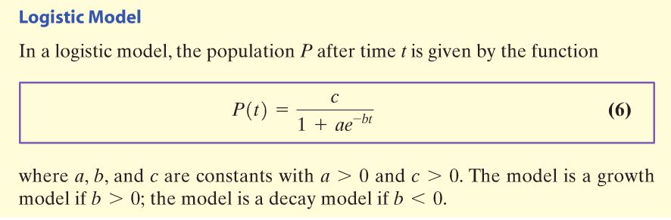
Copyright © 2012 Pearson Education, Inc. Publishing as Prentice Hall.

Slide 16
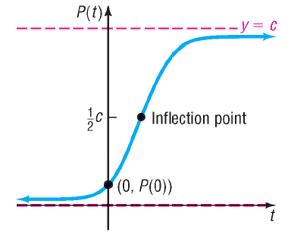
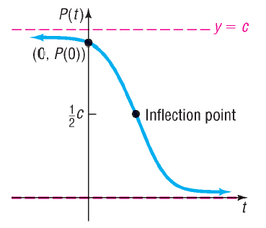
Copyright © 2012 Pearson Education, Inc. Publishing as Prentice Hall.

Slide 17
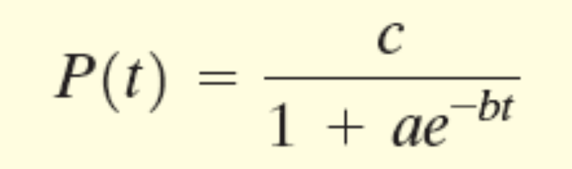
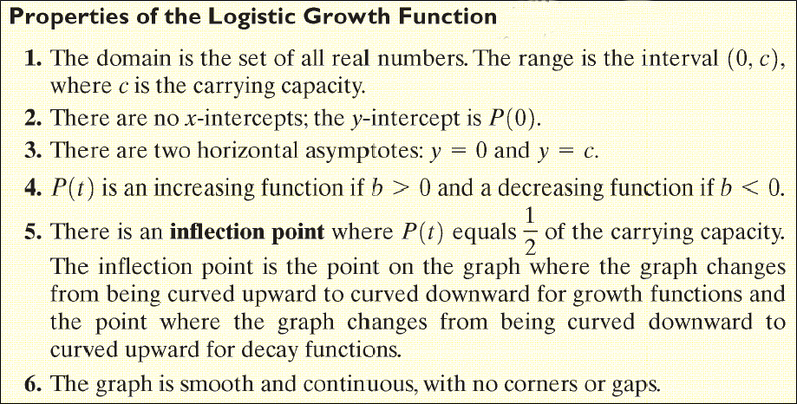
Copyright © 2012 Pearson Education, Inc. Publishing as Prentice Hall.

Slide 18

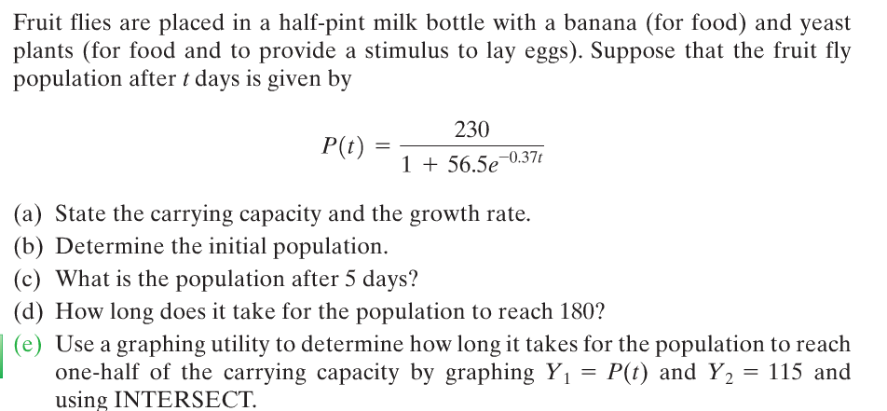
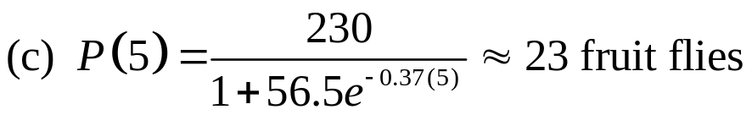
Copyright © 2012 Pearson Education, Inc. Publishing as Prentice Hall.

Slide 19








Copyright © 2012 Pearson Education, Inc. Publishing as Prentice Hall.

Slide 20


510
Y₂
Y₁
0
300
-10
Copyright © 2012 Pearson Education, Inc. Publishing as Prentice Hall.

Slide 21



Copyright © 2012 Pearson Education, Inc. Publishing as Prentice Hall.

Slide 22







Copyright © 2012 Pearson Education, Inc. Publishing as Prentice Hall.

